Slide 1

COIT11241 – CYBER SECURITY TECHNOLOGIES
James Ira Arellano – 12161580
Assignment 2 – Wk9: Attack

Slide 2
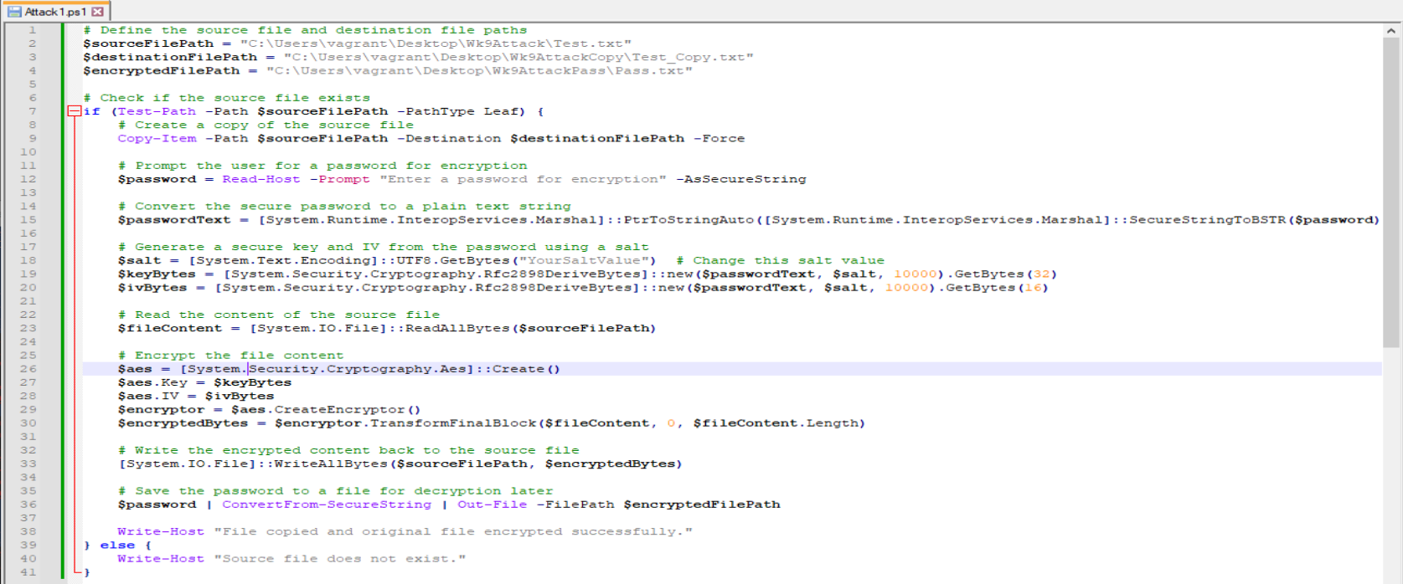
Emulating Attacks – Take a Copy and Encrypt Original File
According to Murphy (2023), BlackCat uses a “triple extortion” technique that involves attackers making a copy of a victim’s file and then encrypts it so the user cannot access the file.
An example script was made that targets a specific file and its path, creates a copy of the original file, and stores the encryption password somewhere else.
Script Resource: https://chat.openai.com/share/d0c58203-a638-4955-853b-ea29ce9295fd

Slide 3
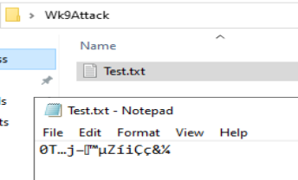
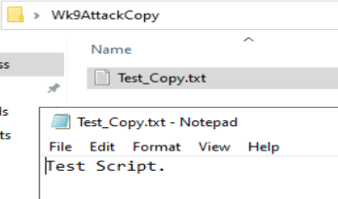
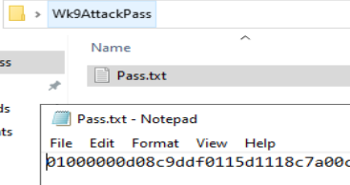
Emulating Attacks – Take a Copy and Encrypt Original File
The first part of the script defines 3 paths: the path of the targeted file, the path of where to place the copy and the path to store the encrypted password. These can all be changed by an attacker depending on their situation and needs.
ATT&CK’s relevant to this script involves:
T1546.013 – Event Triggered Execution: PowerShell Profile
T1027 – Obfuscated Files or Information
T1486 – Data Encrypted for Impact
Invoking ScriptAnalyzer only noted PSAvoidUsingWriteHost which was an easy fix to clear the warning. (This is done by replacing Write-Host by Write-Output)

Slide 4
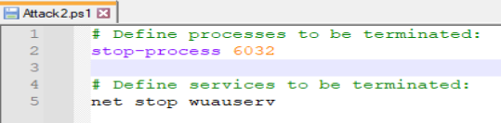

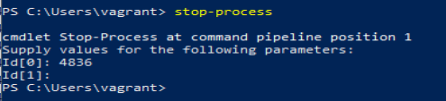
Emulating Attacks – Terminating Processes
According to Murphy (2023), BlackCat is highly configurable and can do things such as terminating services and processes. It is not made clear what exact services and processes were terminated when hit by the actual ransomware itself, but we can infer that it could terminate critical Windows processes and services that could hinder use of a computer.
Process and Service termination can simply be done in PowerShell command line without a script. However, this does not exclude attackers from creating a script or any form of attack that utilises the PowerShell command line to execute these commands:
Note that this is only a fundamental emulation of how attacks on process termination could be executed, an attacker could target more crucial processes and services to aid in their attack.

Slide 5

Emulating Attacks – Terminating Processes
ATT&CK’s relevant to these commands are:
T1543.003 – Create or Modify System Process: Windows Service
T1059.001 – Command and Scripting Interpreter: PowerShell
T1489 – Service Stop
T1562.001 – Impair Defenses: Disable or Modify Tools

Slide 6
Emulating Attacks – Hampering Recovery Methods
According to Microsoft (2023), BlackCat has numerous methods that makes recovery efforts more difficult. These are commands that can be launched by a payload or from other means.
Modifying boot loader:
“C:\Windows\system32\cmd.exe” /c “bcdedit /set {default}”
“C:\Windows\system32\cmd.exe” /c “bcdedit /set {default} recoveryenabled No”
Deleting volume shadow copies
“C:\Windows\system32\cmd.exe” /c “vssadmin.exe Delete Shadows /all /quiet”
“C:\Windows\system32\cmd.exe” /c “wmic.exe Shadowcopy Delete”
Clear Windows event logs
“C:\Windows\system32\cmd.exe” /c “cmd.exe /c for /F \”tokens=*\” Incorrect function. in (‘ wevtutil.exe el ‘) DO wevtutil.exe cl \”Incorrect function. \””
Due to the dangerous nature of these commands, a script is not made to test these cases.

Slide 7

Emulating Attacks – Hampering Recovery Methods
ATT&CK’s relevant to these commands are:
T1070.001 – Indicator Removal on Host: Clear Windows Event Logs
T1547 – Boot or Logon Autostart Execution
T1490 – Inhibit System Recovery

Slide 8
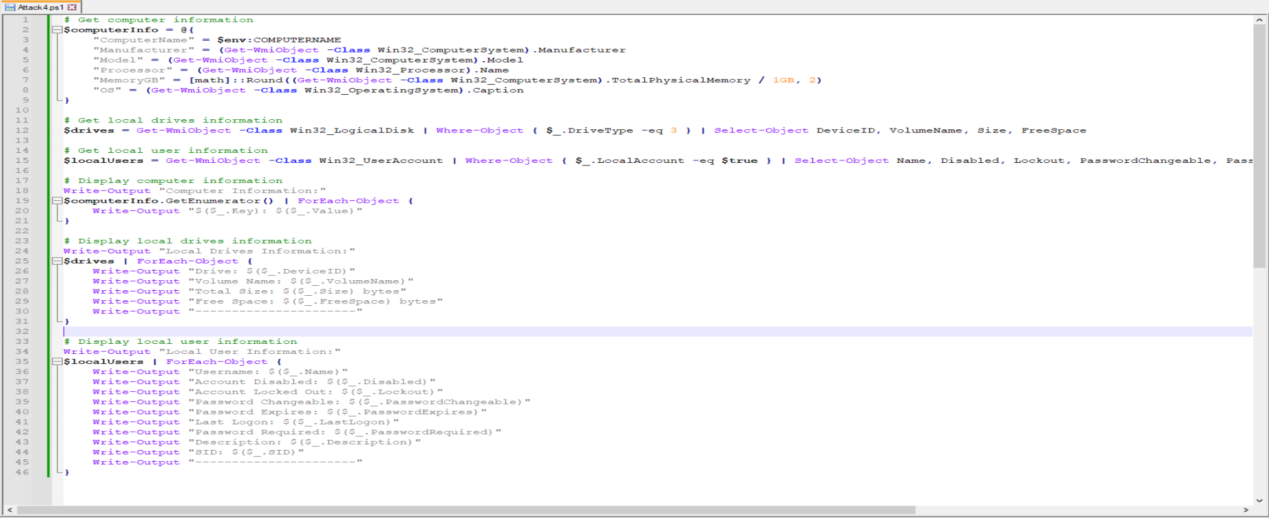
Emulating Attacks – Device Enumeration
BlackCat is capable of determining various forms of information on the computer it is on such as system, local drives, hardware info and various info about their local users. This could help in the malware identifying what devices it is capable of attacking.
Script Resource: https://chat.openai.com/share/323814d4-74b8-46fe-84fe-38bd32d192b3

Slide 9
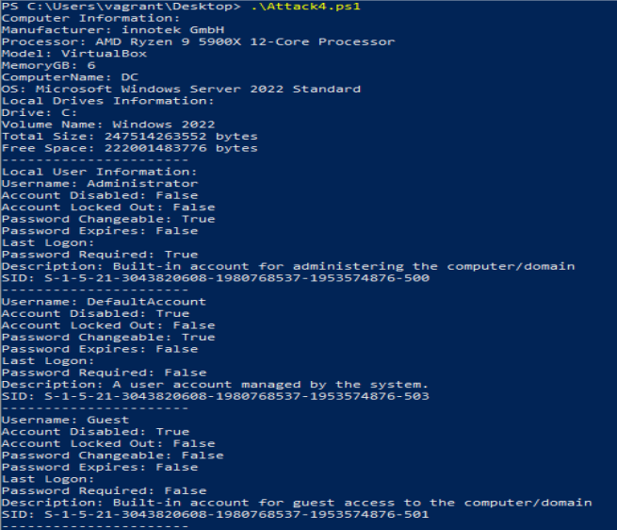
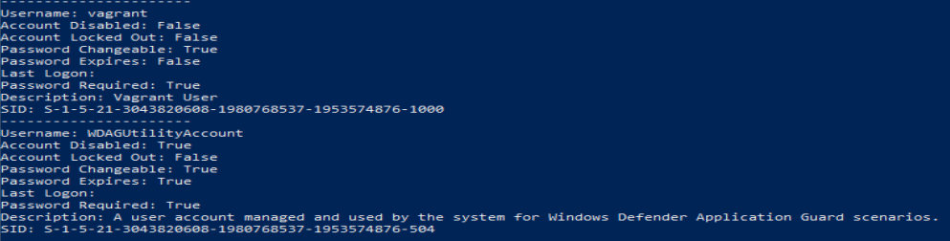
Emulating Attacks – Device Enumeration
An example output of this script reveals this information:

Slide 10
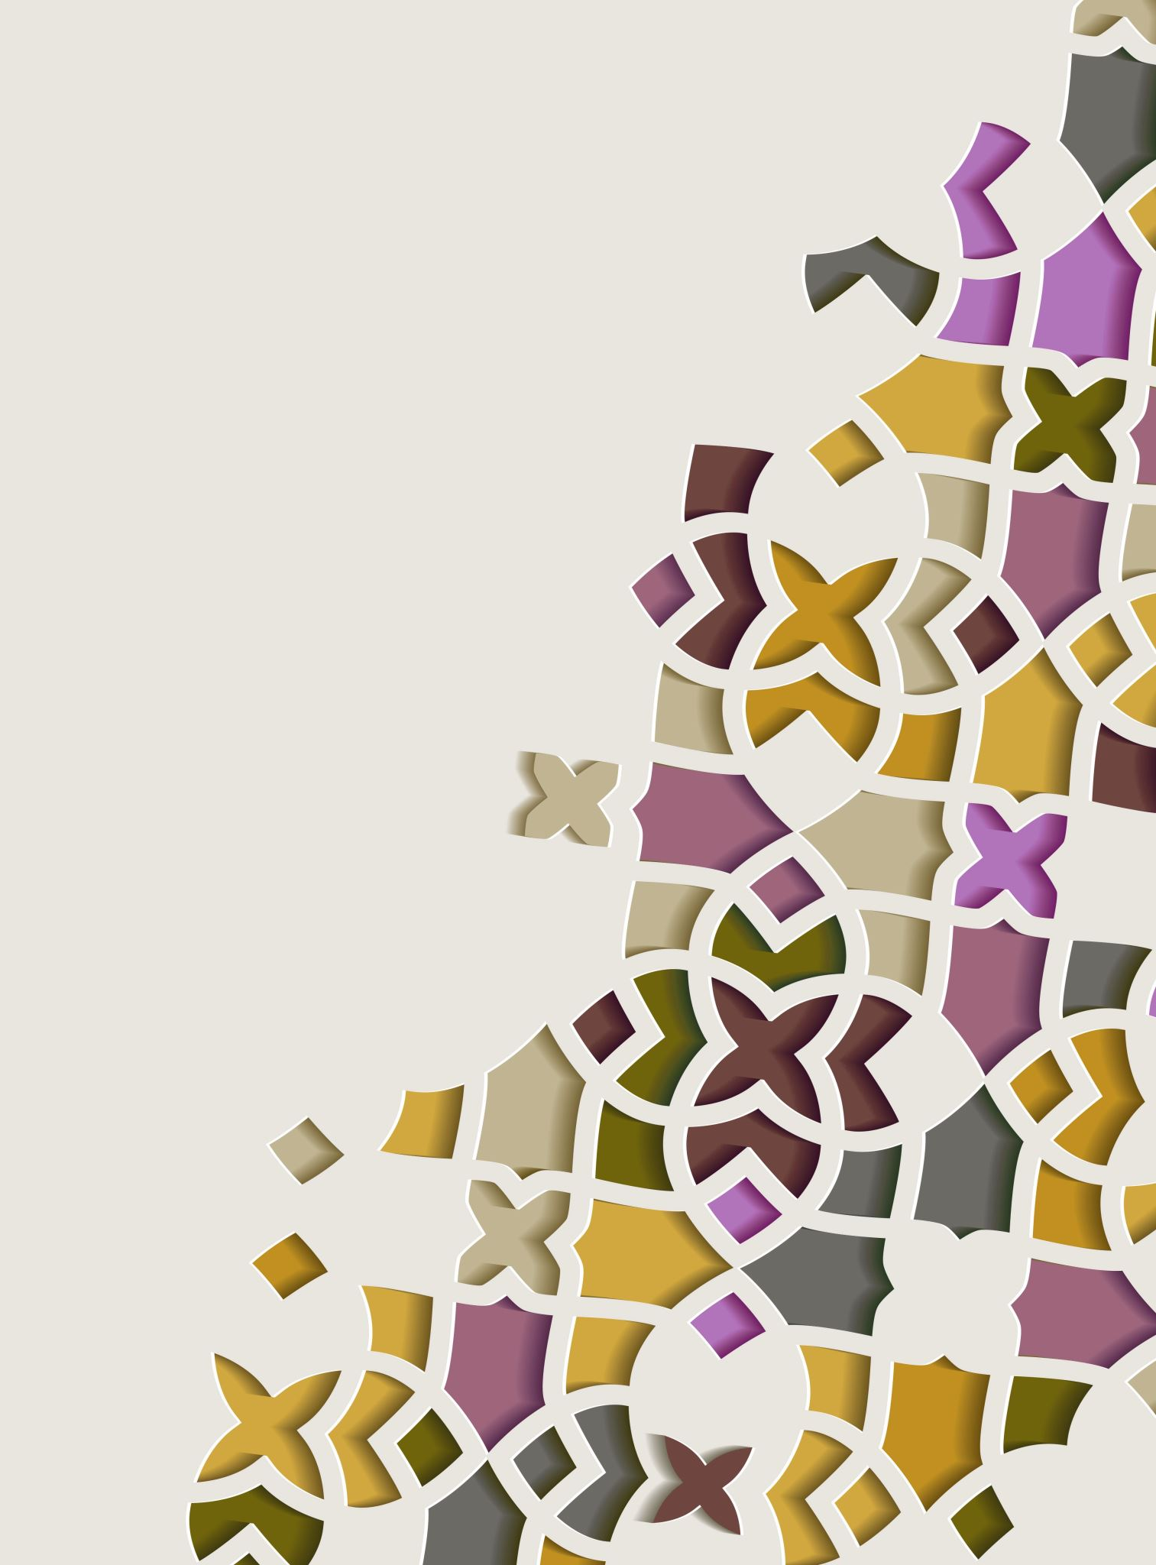
Emulating Attacks – Device Enumeration
ATT&CK’s relevant to these commands are:
T1082 – System Information Discovery
T1560 – Archive Collected Data
T1033 – System Owner/User Discovery
T1087.002 – Account Discover: Domain Account
T1007 – System Service Discovery

Slide 11
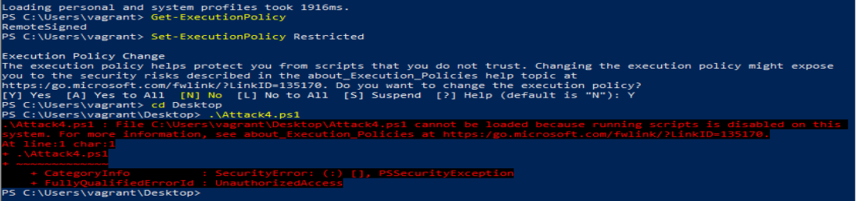
Implementing Detections and Preventions – PowerShell Execution Policy
Since the emulated attacks are predominantly PowerShell based, a good prevention method would be to change the execution policy to restrict unwanted scripts from running.

Slide 12
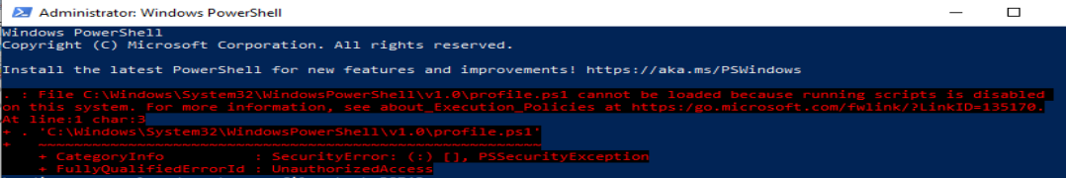
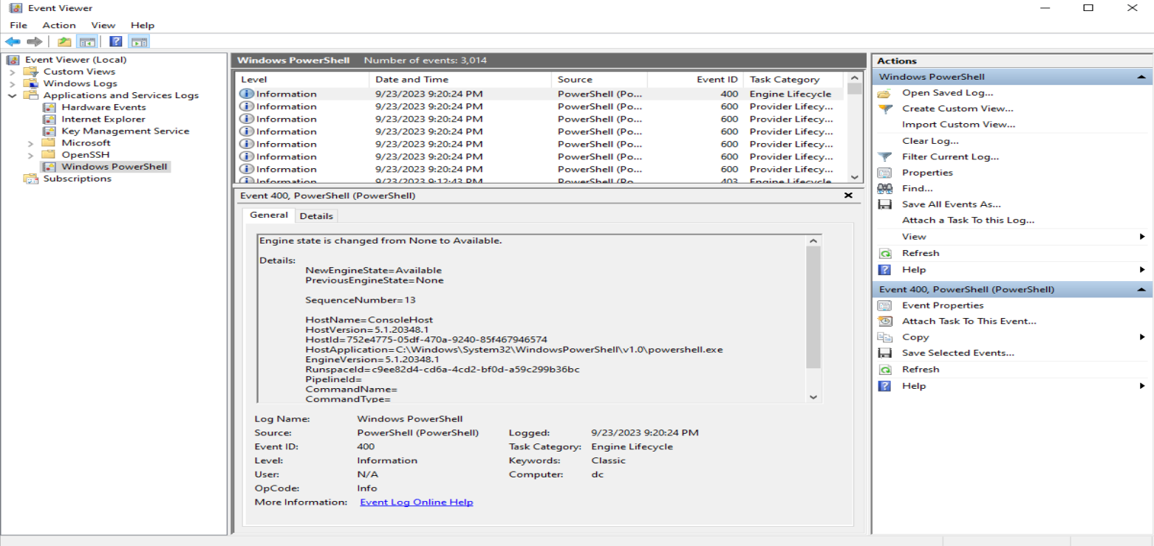
Implementing Detections and Preventions – PowerShell Execution Policy
By changing this Execution Policy, opening PowerShell results in a start-up error. It also then logs events in Event Viewer when you start a PowerShell window.

Slide 13
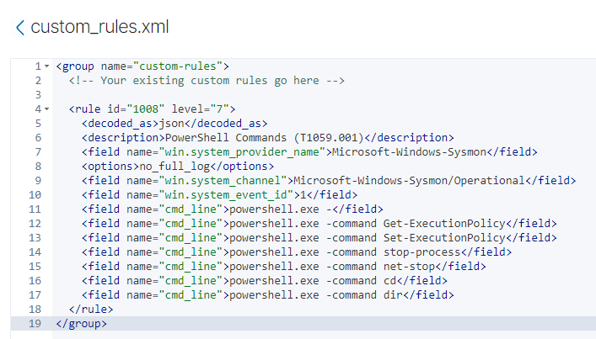
Implementing Detections and Preventions – Wazuh Rules 1
Further improving the Restricted Execution Policy, would be a Wazuh rule to detect T1059.001 (PowerShell) attacks if the attack were to bypass Execution Policies and some other common commands such as navigation (cd, dir) and process or service termination (net stop, stop-process)

Slide 14
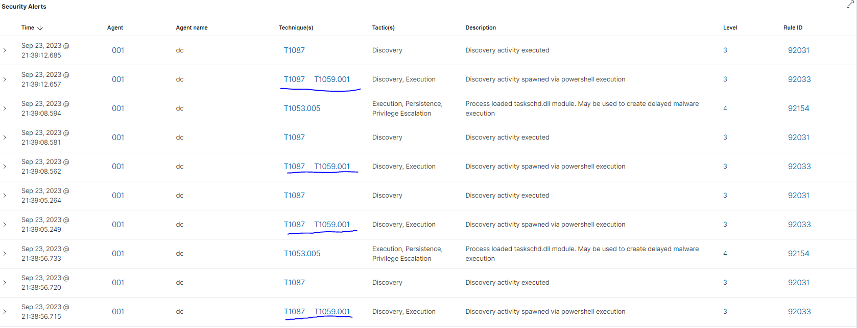
Implementing Detections and Preventions – Wazuh Rules 1
Here are Security Alerts that was triggered by T1059.001 (PowerShell)

Slide 15
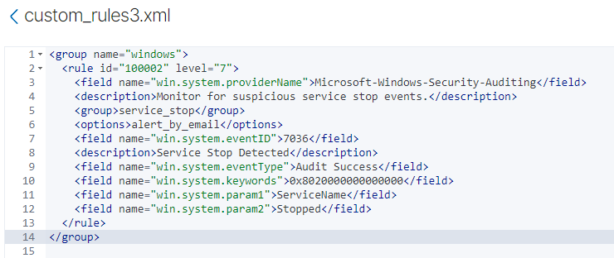
Implementing Detections and Preventions – Wazuh Rules 3
Another rule added monitors suspicious service stop events T1489. This is a rule to show possibly non-normal process and service termination or modifications when payloads or other executables were launched.

Slide 16
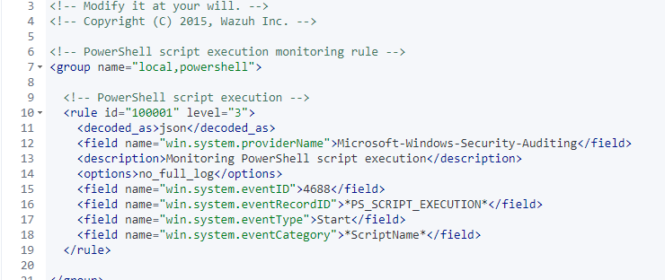
Implementing Detections and Preventions – Wazuh Rules 4
Another rule added to monitor is unathorised PowerShell script execution. This is slightly different from the first rule which is meant to detect use of PowerShell. This rule specifically monitor script execution.

Slide 17
Resources
Emulating Attacks – Take a Copy and Encrypt Original File: https://chat.openai.com/share/d0c58203-a638-4955-853b-ea29ce9295fd
Emulating Attacks – Device Enumeration:
https://chat.openai.com/share/323814d4-74b8-46fe-84fe-38bd32d192b3
Implementing Detections and Preventions – Wazuh Rules 1:
https://chat.openai.com/c/b77a373f-aa86-4a66-aa46-66cb6ea74509
Implementing Detections and Preventions – Wazuh Rules 3:
https://chat.openai.com/c/94c6a0ee-6d43-4e2b-b58e-a20af2fd7a87
Implementing Detections and Preventions – Wazuh Rules 4:
https://chat.openai.com/c/ffd9640b-35de-4b3e-95e4-f95d375ed76e
GitHub: https://github.com/AikyanP/COIT11241---WK9-Assignment-2---Attack

Slide 18
Atomic Red Team Library Resources
Emulating Attacks – Take a Copy and Encrypt Original File:
https://atomicredteam.io/persistence/T1546.013/
https://atomicredteam.io/defense-evasion/T1027/
https://atomicredteam.io/impact/T1486/
Emulating Attacks – Terminating Processes:
https://atomicredteam.io/privilege-escalation/T1543.003/
https://atomicredteam.io/execution/T1059.001/
https://atomicredteam.io/impact/T1489/
https://atomicredteam.io/defense-evasion/T1562.001/
Emulating Attacks – Hampering Recovery Methods:
https://atomicredteam.io/defense-evasion/T1070.001/
https://atomicredteam.io/privilege-escalation/T1547/
https://atomicredteam.io/impact/T1490/
Emulating Attacks – Device Enumeration:
https://atomicredteam.io/discovery/T1082/
https://atomicredteam.io/collection/T1560/
https://atomicredteam.io/discovery/T1033/
https://atomicredteam.io/discovery/T1087.002/
https://atomicredteam.io/discovery/T1007/

Slide 19
References
Microsoft Threat Intelligence. (2023). The many lives of BlackCat ransomware. Retrieved from https://www.microsoft.com/en-us/security/blog/2022/06/13/the-many-lives-of-blackcat-ransomware/
Murphy, D. (2023, April 19). What is BlackCat Ransomware and How to Protect Against it? Retrieved from https://www.lepide.com/blog/what-is-blackcat-ransomware/
Red Canary. (2023). Atomics. Retrieved from https://atomicredteam.io/atomics/

